Slide 1
CoDS-I
2034 Annual Report

Slide 2
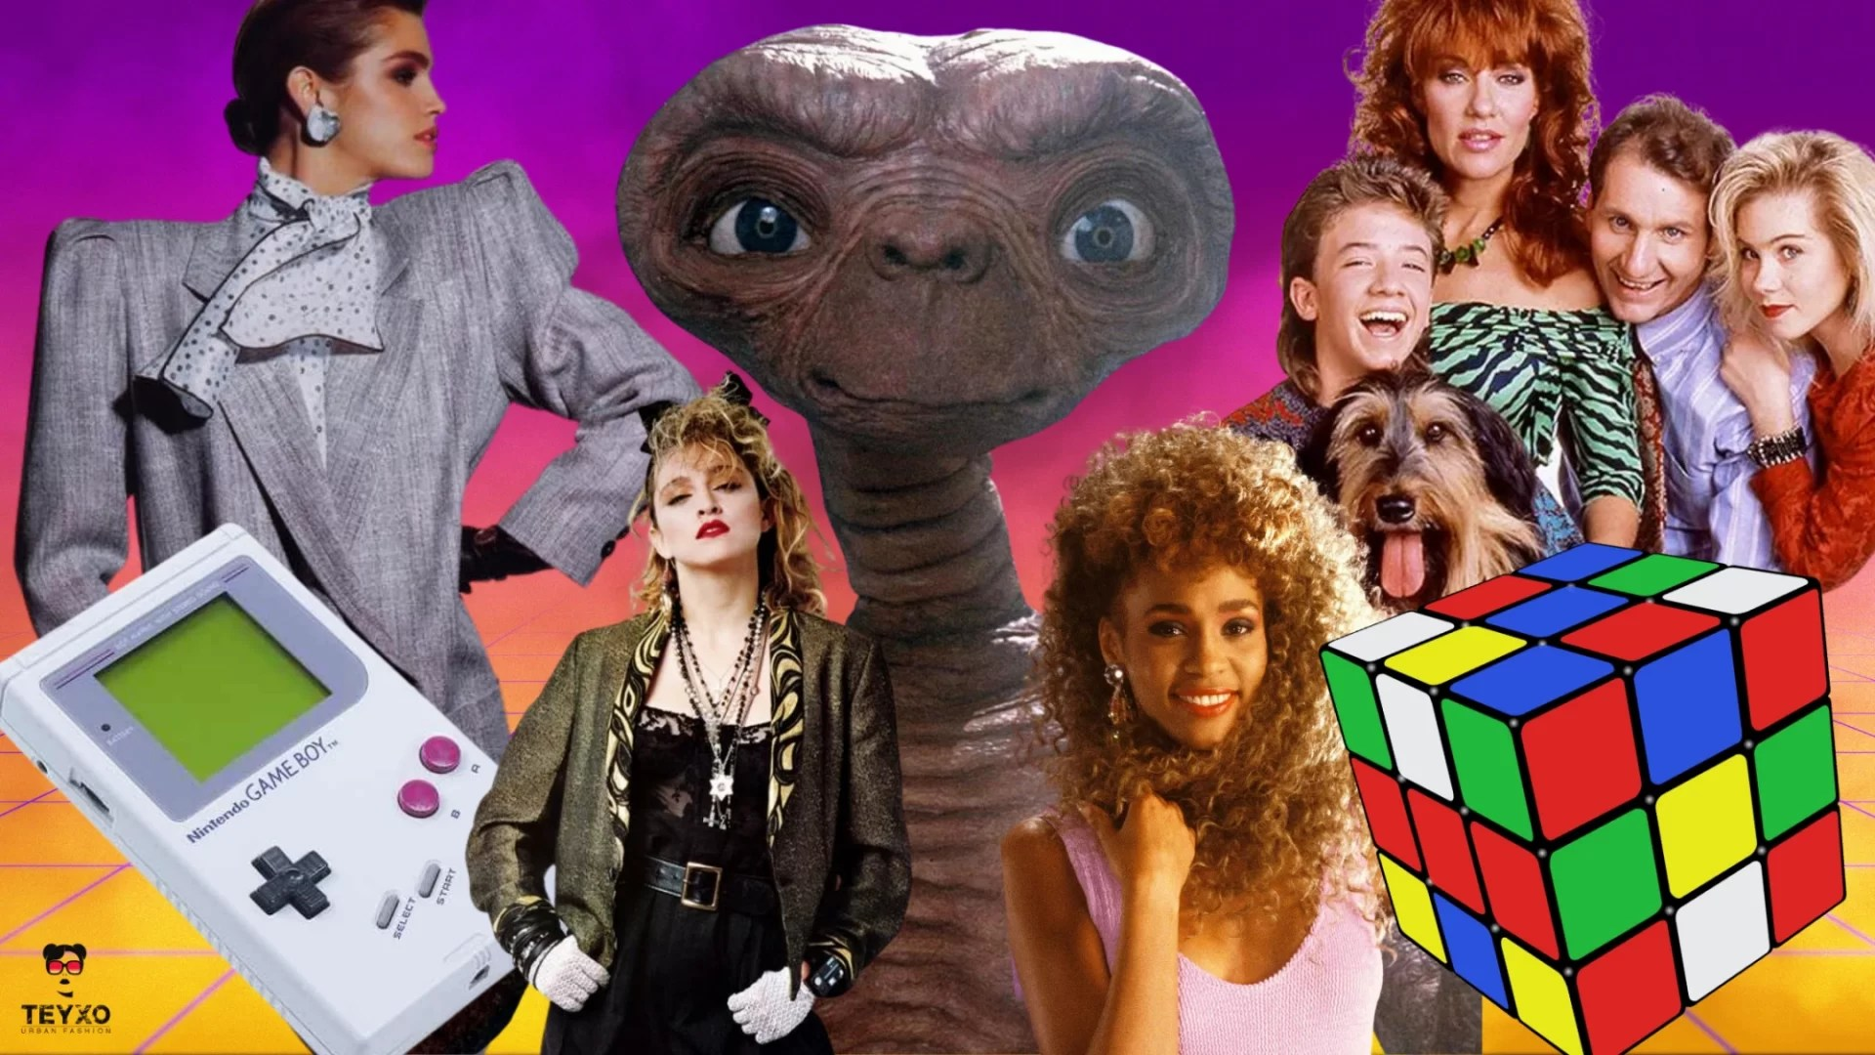
Notes:
As a child of the 80s

Slide 3

Notes:
Vampire themed chat rooms

Slide 4
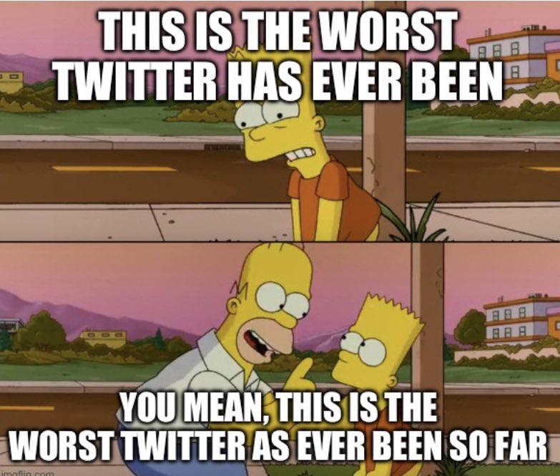
How was it shit-ified
Notes:
Worrying trend towards shitification

Slide 5

Notes:
Violence, abuse, racism, sexism, homophobia, intolerance, transphobia

Slide 6

Notes:
Influencers driving toward monetization driven by our AI overlords

Slide 7

Notes:
Political divisiveness and mistrust

Slide 8
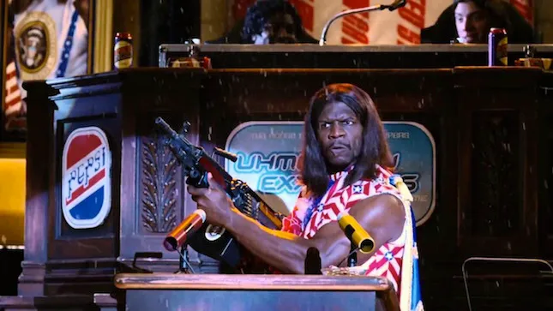
Notes:
General collapse of society and humanity

Slide 9
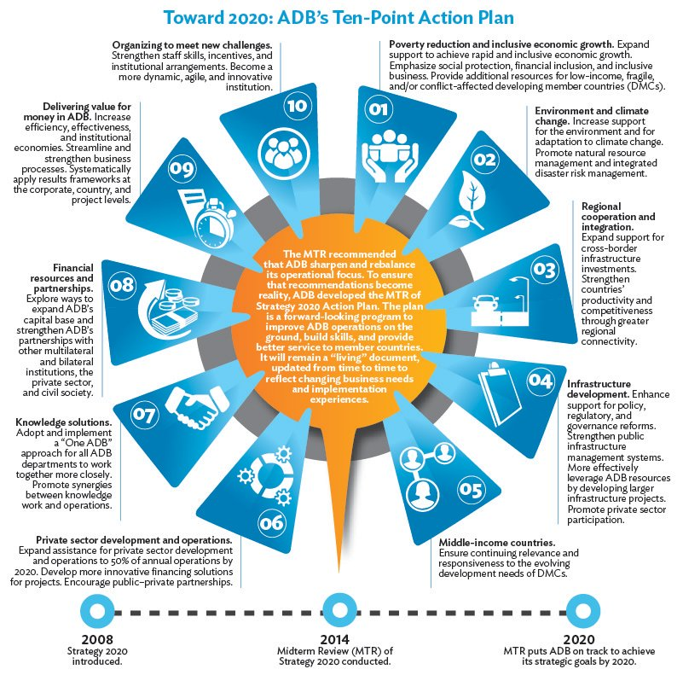

Notes:
Formed and 10 point plan

Slide 10
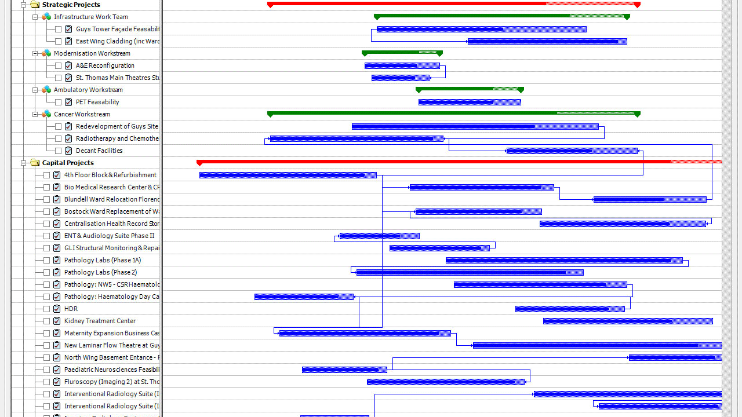
Notes:
Illegalize gantt

Slide 11


Slide 12
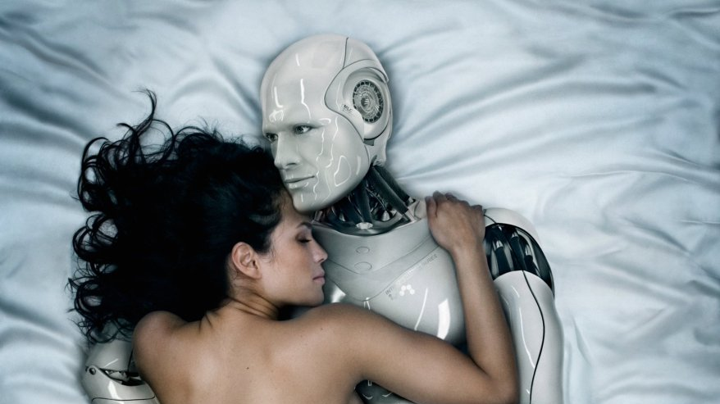
Notes:
Replaced men with sex robots

Slide 13

Notes:
Funded that mars mission

Slide 14
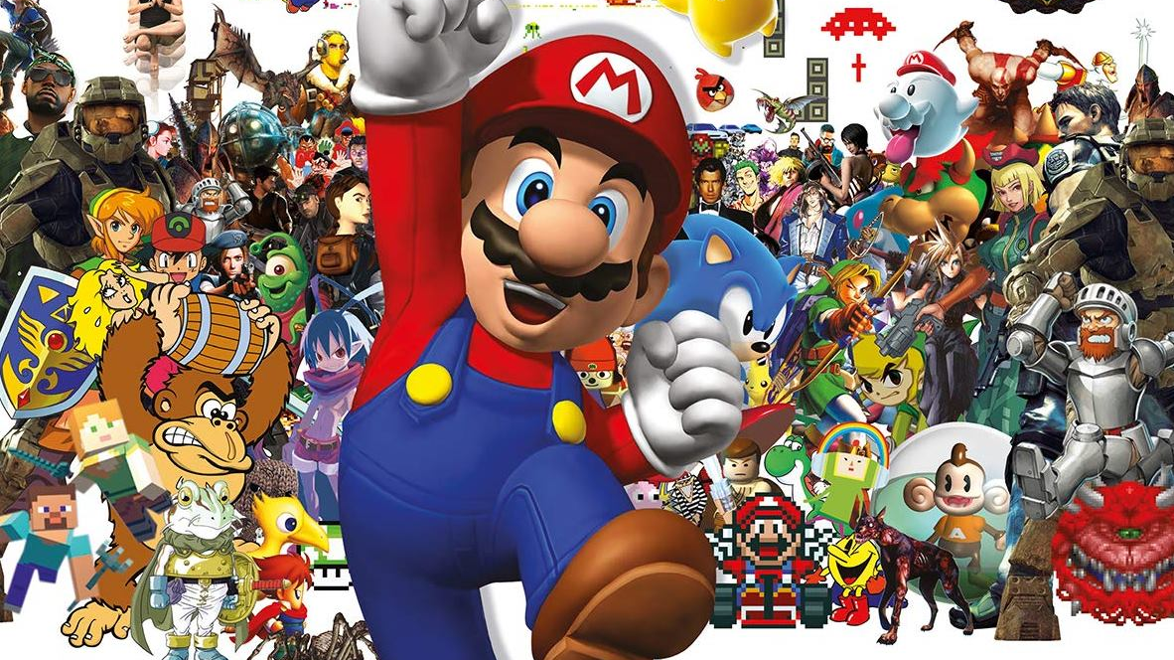
Notes:
Bread and circuses

Slide 15
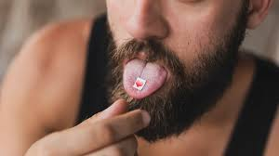
Notes:
Mandatory LSD usage and meditation retreats

Slide 16

Notes:
Improvements to the food production process

Slide 17


Slide 18
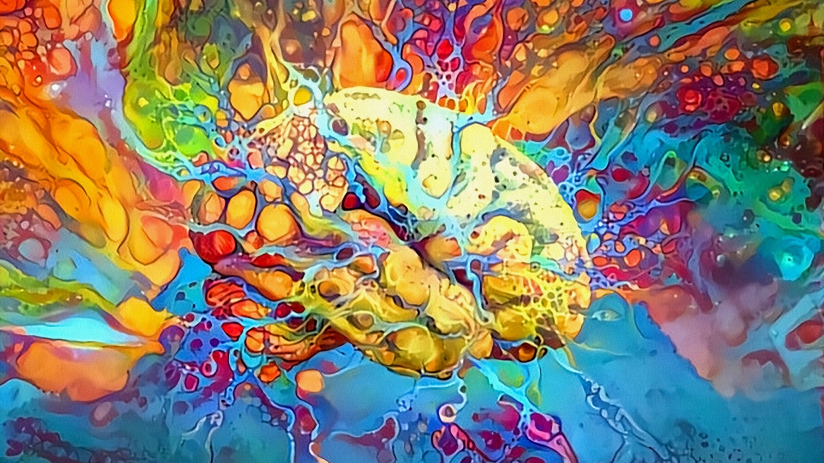
Notes:
creativity

Slide 19
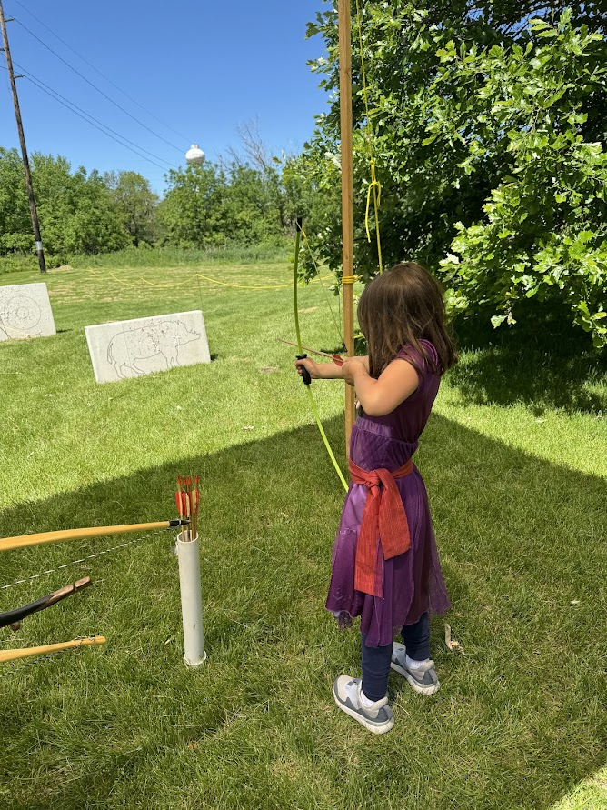
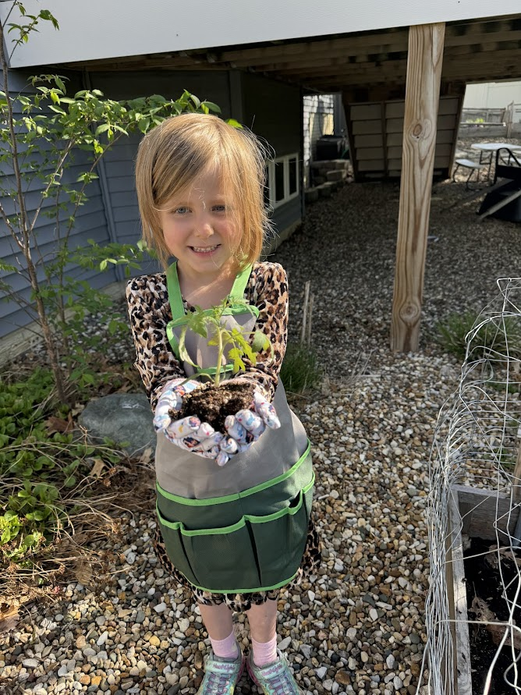
Notes:
Children growing up with joy and knowledge of the out of doors (and cos play)

Slide 20
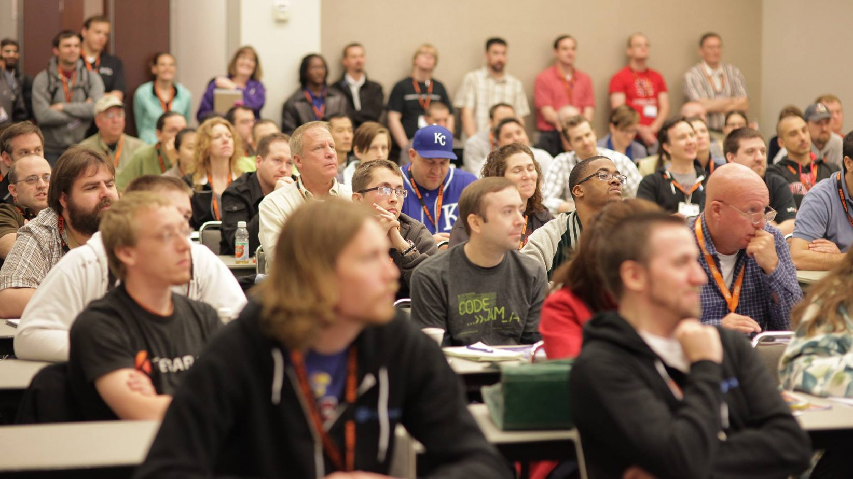
Notes:
Bringing together community – safe places

Slide 21

Notes:
COBOL still runs the world

